Slide 1
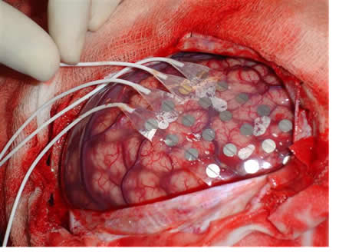
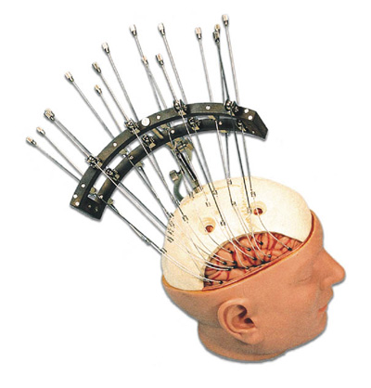
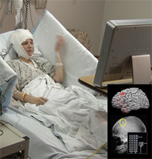
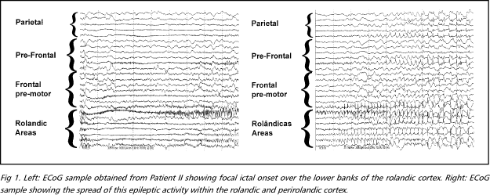
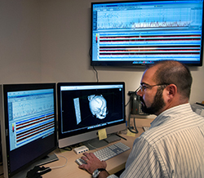
Electrode Implantation
Monitoring (Days/Weeks)
Clinical Team Attempts to Localize Visually
Hours of time

Slide 2
DNN Predicts
Compare to doctors

Slide 3
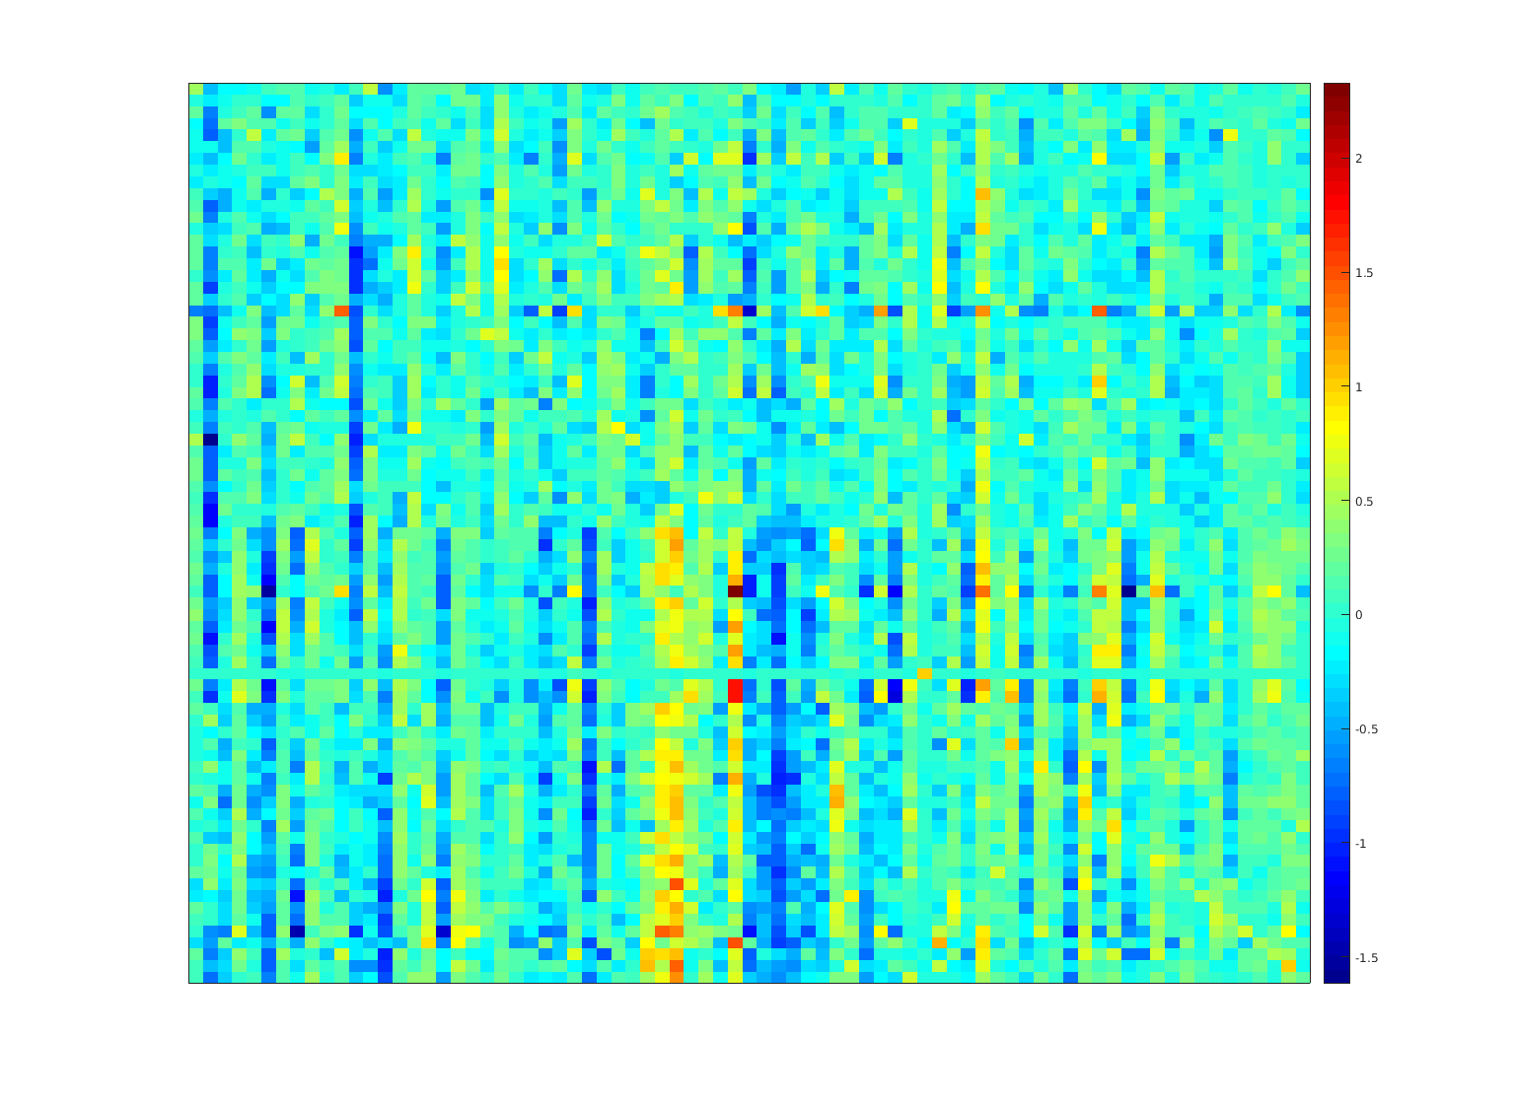
. . .
. . .
MultiTaper FFT

